Slide 1

AI in Our Team – Strategy Deck
Innovative approaches to integrating artificial intelligence
Notes:
AI-generated content may be incorrect. ---

Slide 2

Current State
Varied AI Adoption Levels
Team members exhibit wide-ranging AI usage, from advanced daily use to uncertainty and resistance.
Fragmented Usage Patterns
AI use is inconsistent and dependent on individual initiative without shared standards or alignment.
Challenges from Uneven Adoption
Uneven AI adoption causes inconsistent outputs, knowledge silos, and collaboration difficulties.
Opportunity for Inclusive Strategy
Recognizing current gaps highlights the need for a unified, intentional AI adoption strategy.
Notes:
Our current state with AI across the team is highly variable, reflecting a wide spectrum of comfort levels, skills, and adoption patterns. On one end of the spectrum, we have team members who use AI daily as a core part of how they think, create, and execute their work. Some of these advanced users are already designing workflows, building lightweight bots, automating repetitive tasks, and significantly increasing both their speed and quality of output. For them, AI is no longer a novelty but a productivity multiplier and creative partner. However, this level of usage is not consistent across the team. On the other end, we have team members who feel uncertain, uncomfortable, or even resistant to AI tools. Common barriers include a lack of clarity on how AI applies to their role, fear of getting started incorrectly, concerns about time required to learn something new, or skepticism about the value AI can deliver. Between these extremes sits a large middle group that uses AI occasionally but without clear standards, shared practices, or alignment on what “good” looks like. As a result, AI usage today is largely fragmented, ad hoc, and dependent on individual initiative rather than designed team capability. This uneven adoption creates several challenges. First, it leads to inconsistent outputs in terms of quality, structure, and clarity. Second, there is a real risk of knowledge silos, where those who have discovered effective prompts, workflows, or tools unintentionally hoard information rather than sharing it. Third, without shared expectations or guardrails, AI is underutilized as a mechanism for auditing work, improving standards, or aligning around end-user needs. Finally, this fragmentation can exacerbate existing collaboration challenges, reinforcing individual ways of working instead of strengthening the team as a cohesive unit. Understanding this current state is critical, because it highlights both the urgency and the opportunity for a more intentional, inclusive AI strategy.

Slide 3

AI Opportunity
Elevating Collaboration Standards
AI helps define and reinforce shared standards through templates, checklists, and quality benchmarks.
Reducing Cognitive Load
AI automates repetitive tasks, freeing up time for higher-value thinking and problem solving.
User-Centered Program Design
AI simulates user perspectives to improve empathy, feedback analysis, and program clarity.
Unifying Team Collaboration
Shared AI tools and practices enable collective impact, transforming individual efforts into team success.
Notes:
The opportunity in front of us is not simply to increase AI usage, but to use AI deliberately to elevate how we work together, the standards we uphold, and the value we deliver to end users. At its best, AI can act as a force multiplier that helps close skill gaps, reduce friction, and bring clarity to complex work. One of the most immediate opportunities is establishing better shared standards. AI can help us define, document, and reinforce what “good” looks like by generating examples, templates, checklists, and quality bars that everyone can reference and build from. AI also presents a powerful opportunity to ease workflows and reduce unnecessary cognitive load. Many tasks the team performs are repetitive, administrative, or require reworking content multiple times. These are ideal candidates for AI assistance, freeing up time and energy for higher-value thinking, collaboration, and problem solving. In addition, AI can be used as a built-in audit and quality assurance layer. By reviewing drafts, checking for clarity or alignment with objectives, and highlighting gaps, AI can help us improve outputs before they ever reach stakeholders or end users. Another critical opportunity lies in designing more end-user–focused programs. AI can help us step out of internal assumptions and more consistently view our work through the lens of the people we serve. By simulating user perspectives, summarizing feedback, and stress-testing messaging or program design against user needs, AI becomes a practical tool for empathy and clarity, not just efficiency. Finally, AI can be a unifying capability for the team if positioned correctly. When shared tools, language, and practices are adopted, AI becomes a collaboration enabler rather than a divider, helping us move from individual excellence to collective impact.

Slide 4
Recommended Tools & Use Cases
Generative AI Assistants
Think • Draft • Improve
Workflow Automation & AI
Standardize • Scale • Reduce Friction
AI Review & Quality Checks
Align • Audit • Reduce Rework
M365 Copilot / Copilot Chat / ChatGPT (approved)
Draft first versions, summarize content, improve clarity and tone
Use iteratively; human review is always required
Power Automate (with Copilot), SharePoint, Loop
Automate repeatable tasks, intake flows, reviews, and reporting
Enable consistent processes without manual overhead
Copilot review flows, shared prompt templates
Check work against standards, audience needs, and risks
Promote consistency and shared expectations

Slide 5

Implementation Roadmap
Phase One: Baseline Alignment
Focus on clear guidance for responsible AI use with simple, role-relevant examples.
Phase Two: Shared Use Cases
Collaborate to define workflows for AI use, introducing templates and encouraging knowledge sharing via demos and peer examples.
Phase Three: Advanced Adoption
Enable advanced users to build sophisticated workflows and embed AI into daily operations with peer coaching roles.
Notes:
Successfully implementing AI across the team requires a phased, human-centered approach that meets people where they are while creating momentum toward more advanced use. Phase one focuses on baseline alignment and psychological safety. This includes clear guidance on approved tools, responsible use, and simple, role-relevant examples that demonstrate immediate value. The goal is not mastery, but comfort and clarity. Shared norms should be established, such as when to use AI, how to reference it in work, and how outputs should be reviewed. Phase two emphasizes shared use cases and standardization. During this phase, the team collaboratively defines priority workflows and deliverables where AI can make a meaningful difference. Templates, example prompts, and “before and after” artifacts are introduced to show what good looks like. Importantly, this phase encourages knowledge sharing through short demos, peer examples, and lightweight communities of practice, directly addressing the risk of information hoarding. Phase three unlocks advanced capability and sustained adoption. Advanced users are encouraged to build more sophisticated workflows and act as peer coaches, not gatekeepers. AI becomes embedded into the team’s operating rhythm, supporting planning, execution, review, and iteration. Throughout all phases, communication reinforces that change is expected, learning is supported, and improvement is continuous. This roadmap balances speed with inclusivity, ensuring that AI adoption strengthens the team rather than fragmenting it.

Slide 6
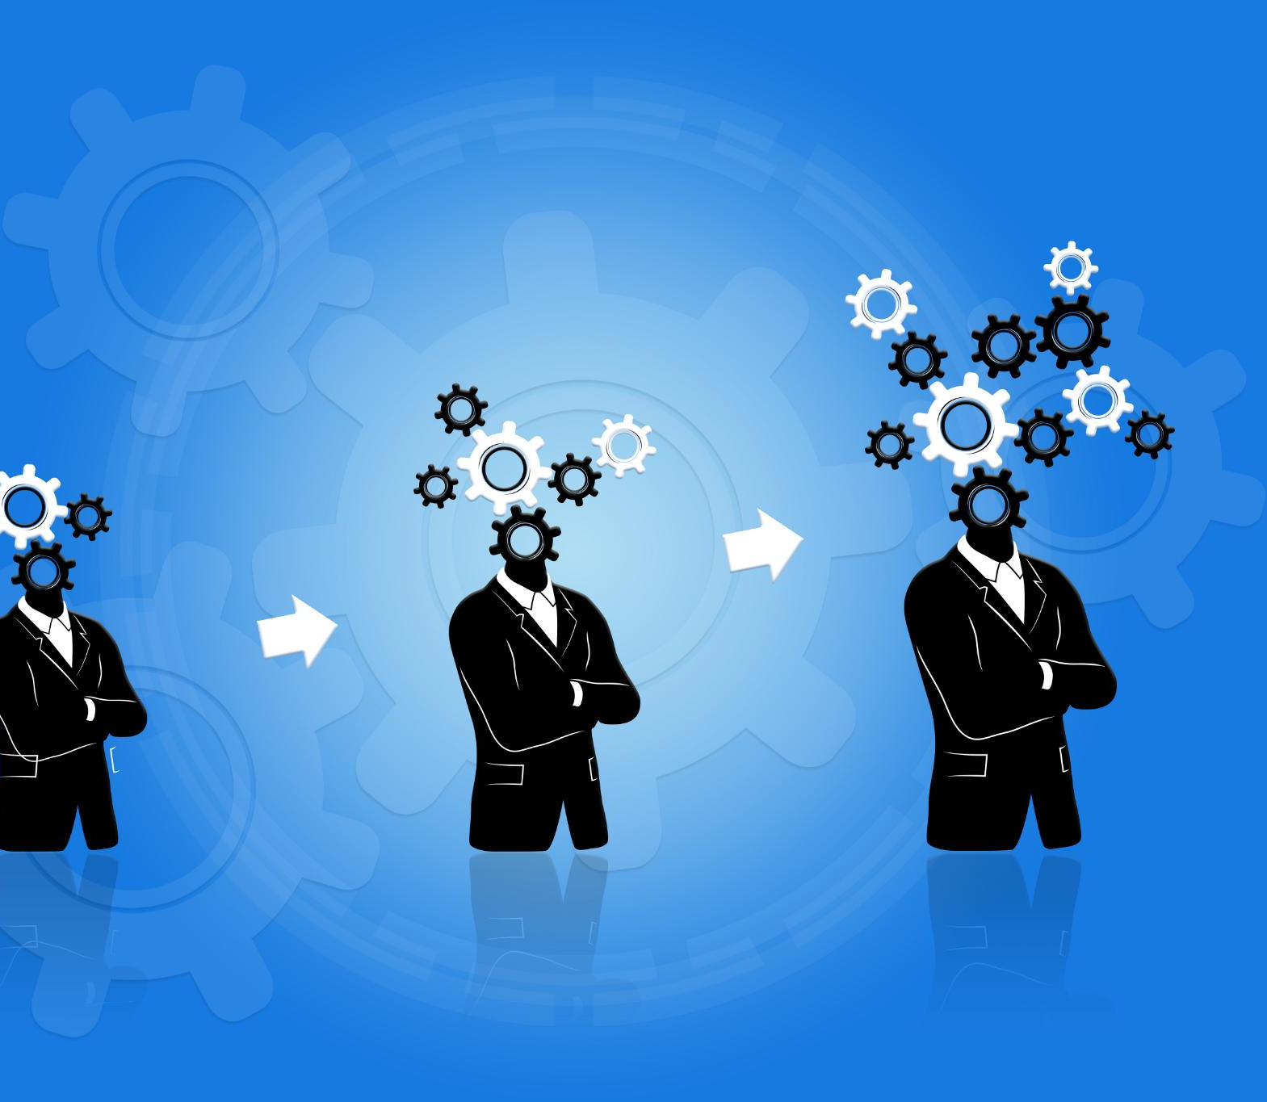
Risks and Mitigations
Resistance to Change
Resistance stems from comfort with old methods of work, uncomfortableness with AI tools, and perhaps a fear of AI replacing jobs; this can be mitigated by framing AI as an assistant/tool.
Information Hoarding
Knowledge hoarding by advanced users limits team growth; rewarding sharing and recognition promotes communal learning.
Uneven Adoption
Uneven AI adoption creates silos; standardized workflows and shared templates reduce fragmentation and unify processes.
Maintaining Collaboration
Optimizing individual output can hurt team alignment; shared reviews and collective planning strengthen collaboration.
Notes:
While the benefits of AI adoption are significant, there are real and human risks that must be acknowledged and proactively mitigated. One major risk is resistance to change, particularly from individuals who are comfortable with existing ways of working or who perceive AI as a threat rather than a support. This can be mitigated through clear messaging that positions AI as an assistant, not a replacement, and by emphasizing practical, time-saving use cases. Another risk is information hoarding, where advanced users accumulate knowledge and advantage without sharing it. To counter this, the team must intentionally reward knowledge sharing through recognition, visibility, and expectations that learning is communal. Similarly, there is a risk of uneven adoption creating new silos, where some work becomes AI-enabled and other work does not. Standardized workflows, shared templates, and minimum expectations help reduce this fragmentation. There is also a collaboration risk if AI is used to optimize individual output at the expense of shared understanding. This is mitigated by designing AI practices that explicitly support team alignment, such as shared reviews, collective planning prompts, and common quality checks. By openly addressing these risks and embedding mitigations into the strategy, AI adoption becomes a stabilizing force rather than a destabilizing one.

Slide 7
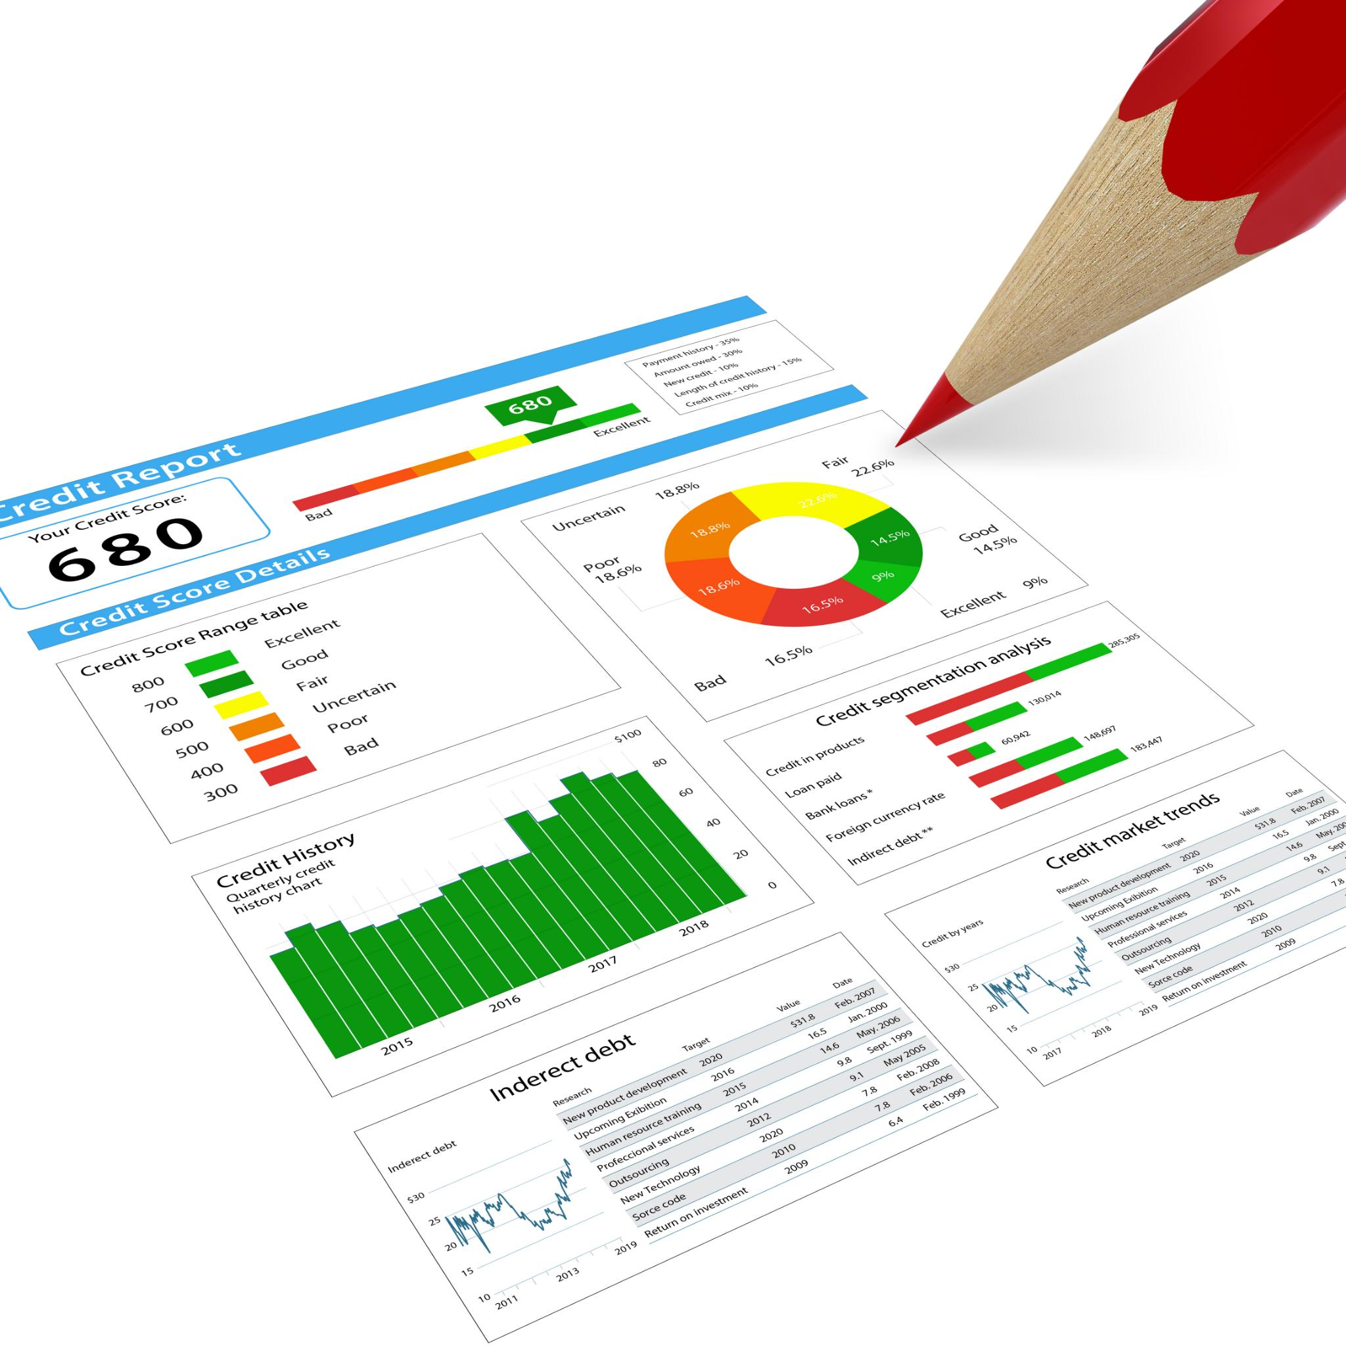
Success Metrics
Adoption Metrics
Track how many team members use AI tools and for which core use cases to monitor reach and support needs.
Efficiency Metrics
Measure time saved and effort reduced in workflows through faster turnarounds and fewer revisions.
Quality and Clarity Metrics
Assess improved feedback, fewer errors, clearer documentation, and better alignment to objectives.
Collaboration and Culture Metrics
Evaluate if AI strengthens the team via sharing templates, consistent outputs, and improved alignment.
Notes:
Measuring success is essential to ensuring that AI adoption delivers real value rather than superficial activity. Success metrics should balance adoption, efficiency, quality, and collaboration. At a foundational level, adoption metrics track how many team members are actively using approved AI tools and for which core use cases. This provides visibility into reach and highlights where additional support may be needed. Efficiency metrics focus on time saved or effort reduced in key workflows. Examples include faster turnaround times, fewer revision cycles, or reduced manual handoffs. These metrics help demonstrate tangible value, particularly to those who may be skeptical. Quality and clarity metrics are equally important and can include improved stakeholder feedback, fewer errors, clearer documentation, or better alignment to objectives as assessed through AI-assisted reviews. Finally, collaboration and culture metrics assess whether AI is strengthening the team rather than isolating individuals. Signals include increased sharing of prompts and templates, more consistent outputs across contributors, and improved cross-team alignment. Qualitative feedback, such as confidence in outputs or perceived clarity of expectations, rounds out the picture. Together, these metrics ensure that AI success is defined not just by usage, but by improved outcomes and a stronger, more unified team.

